Slide 1

Design Critique
Seth Hanusik

Slide 2
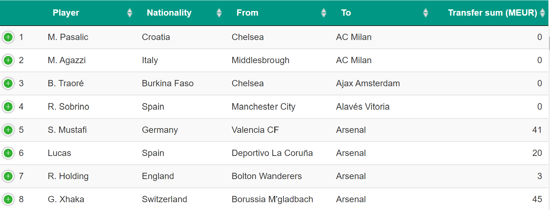
Data
Tabular data with network links
Attributes
Player Name: Nominal
Nationality: Nominal
Seller: Link to buyer, nominal
Buyer: Link to seller, nominal
Transfer Value: quantitative
Transfer Type: nominal
Collected by scraping a website

Slide 3
Visual Representation

Slide 4
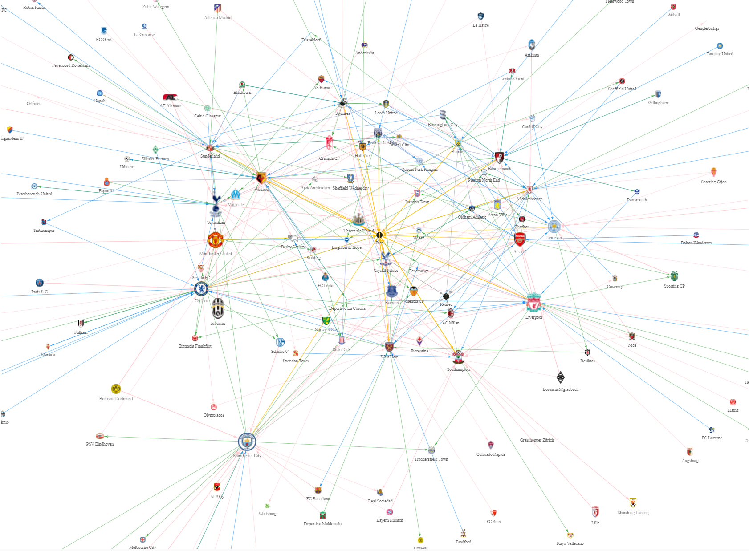
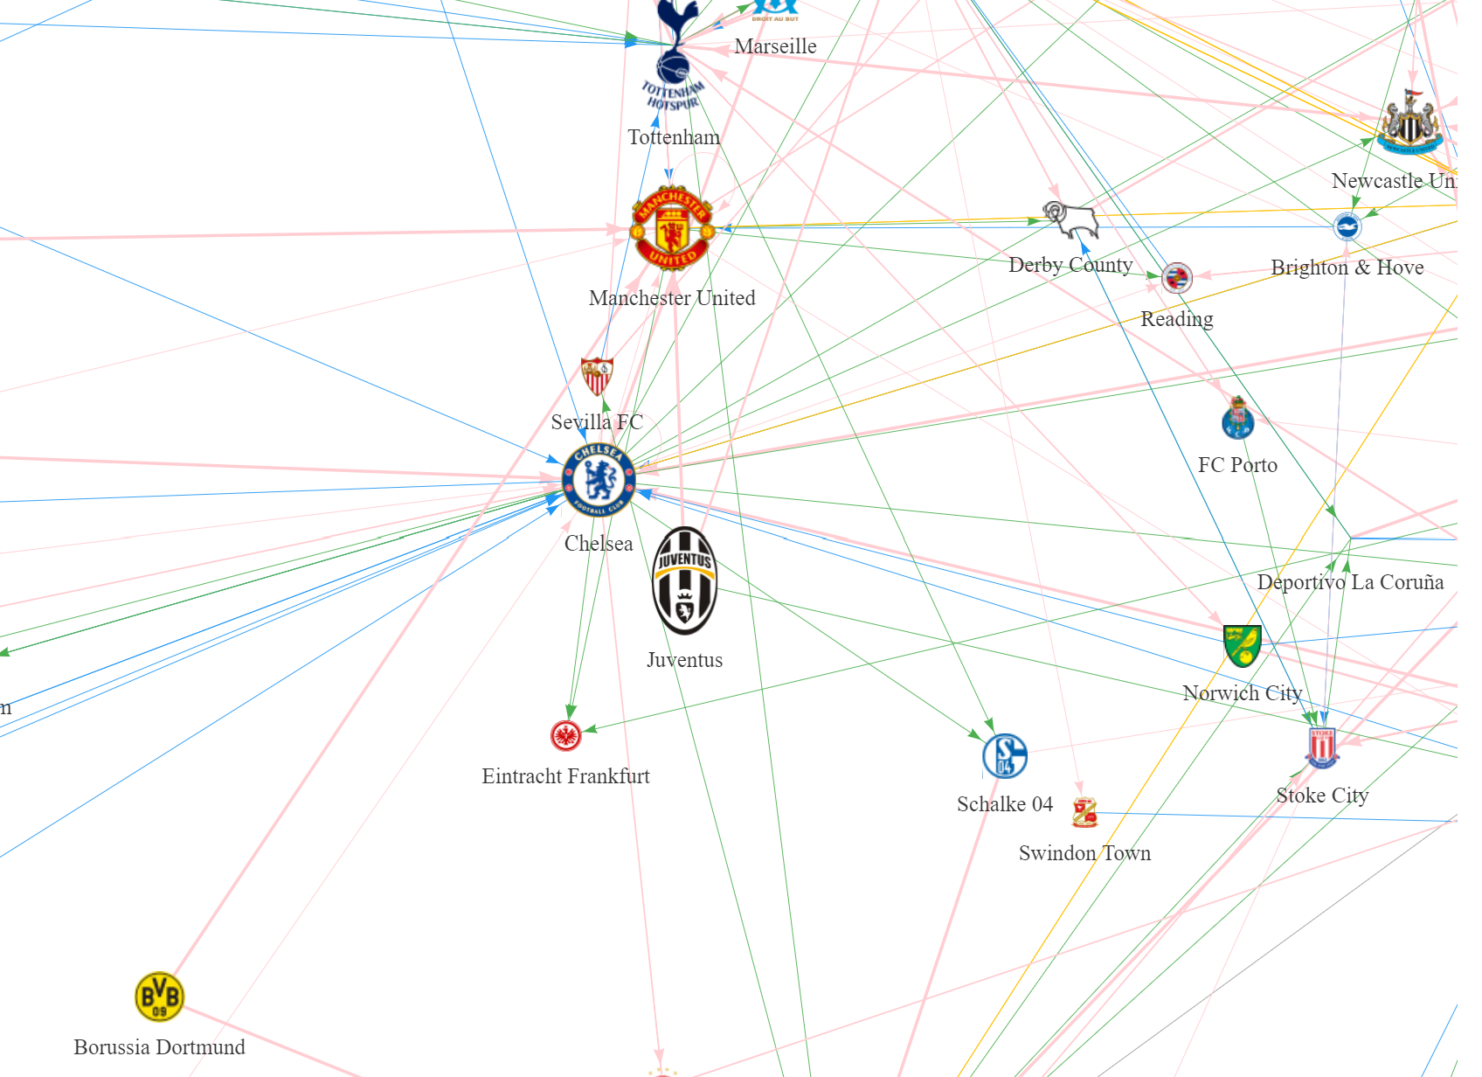
Network
A network with lines drawn from each Premier League club to every club they either sold to or bought from
Connected with a line that represents a transfer
The size of each vertex or club icon represents the total value of all transfers
The color of the line represents the transfer type
Pink: Transfer
Blue: Return from loan
Green: Loan out
Orange: Free transfer
Gray: Retired

Slide 5

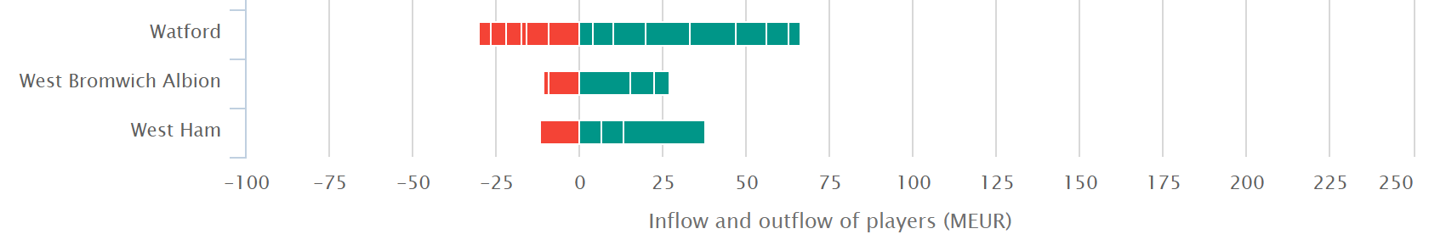
Stacked Bar Chart
Each transfer is represented by a bar
Size is used to represent the value of the transfer
Color is used to represent whether the club is spending or receiving money
The bars are a linear scale, and the clubs along the side are listed in alphabetical order

Slide 6
Interactions

Slide 7
Network
A network with lines drawn from each Premier League club to every club they either sold to or bought from
Connected with a line that represents a transfer
The size of each vertex or club icon represents the total value of all transfers
The color of the line represents the transfer type
Pink: Transfer
Blue: Return from loan
Green: Loan out
Orange: Free transfer
Gray: Retired

Slide 8
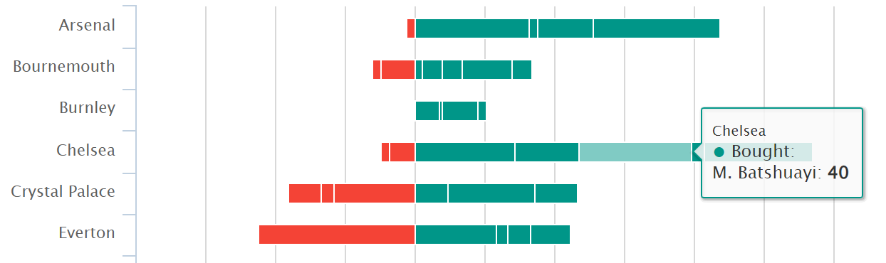
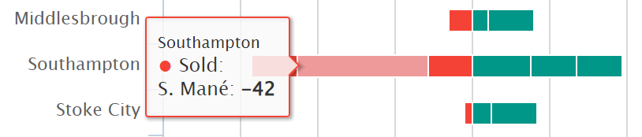
Stacked Bar Chart
Hover over each bar to see a tooltip with the club’s name, player, and plus or minus the money spent or received

Slide 9
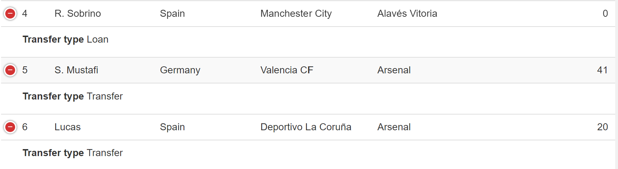
Table
You can change the column’s order by dragging them
Clicking the plus expands a new row showing the transfer type

Slide 10
Purpose

Slide 11
Purpose
While the data is a little outdated, it would allow for fans of Premier League clubs to easily see what kind of money their club is spending on players and exactly who they are acquiring that season
The user can learn exactly what players are moved between clubs and the details of each transfer
Interactions allow the user to narrow the scope of the transfers they are seeing, and how clubs interact with other clubs when it comes to transfers
With the bar chart, you can see that Premier League clubs tend to spend more money than they receive each season on transfers
With the breakdown of specific players, the user can see who the most expensive and cheapest players were

Slide 12
Critique

Slide 13
Critique
Overall, I think they channels they used were very useful for the information that they were portraying, but some specific choices were not ideal
The bar chart colors were confusing because green represents money being spent while red represents money being received
Positioning is such an influential channel, but the network does not position them in any certain way, and they are just sporadically placed on the canvas

